Slide 1
Introduction to Wine

Slide 2
What you will learn in this session
Wine making areas of the World
How wine is made
Grape Varieties
How to read a wine label
The various styles of wine bottles
The correct storage of wine

Slide 3
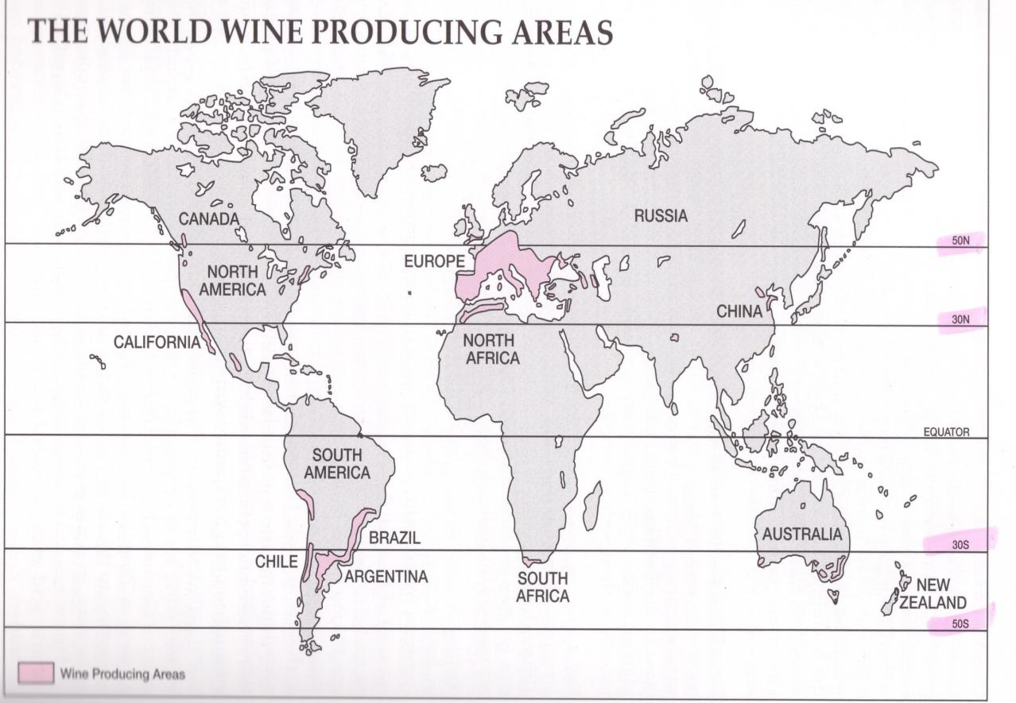

Slide 4
How Wine is Made

Slide 5
Wine definitions
Wine is the fermented juice of grapes
Fermentation:
The process where grape juice turns into wine
Formula: sugar + yeast = alcohol + carbon dioxide
Tannin:
A substance that comes from grape skins, stems & pips
It is a preservative that makes good wines last for years
Vintage:
Refers to the specific year the grapes were harvested
Every year is a vintage year. Some are better than others!

Slide 6
Grape Varieties – Red (Black)
Cabernet Sauvignon
Pinot Noir
Syrah/Syra/Petite Syrah (Shiraz – Australia)
Balsamina (Argentina)
Merlot
Cabernet Franc
Gamay
Grenache (Tinot/Tinta – Spain)
Nebbiolo
Sangiovese (Brunello – Monalcino)

Slide 7
Grape Varieties – White
Riesling
Chardonnay
Semillon (Semillon Blanc - France)
Sauvignon Blanc (Fume Blanc – California, South Africa, Australia & New Zealand)
Chenin Blanc (Steen – South Africa)
Pinot Gris (Pinot Grigio – Italy, Tokay d’Alsace – Alsace, Petit Gris – France)
Pinot Blanc (Pinot Bianco – Italy)
Gewurztraminer
Muscadet (Pinot Blanc – California)
Muscat

Slide 8
France
Produces over 20% of the world’s wines.
Top (per capita) consumer of wine
Set the standard for fine wine production
Grapes were planted in France at least 2,700 years ago before the Roman occupation

Slide 9
Italy
Largest producer of wine in the world
Production is just under 25% of the world’s total
Largest consumer of wine (second largest per capita as population is larger than France)
Italy has been making wine for about 3,500 years
Produces 900 different wines from over 240 geographical regions

Slide 10
South Africa
South African wine had many production problems in the early 1900s (mainly over-production).
In 1918 the Cooperative Wine Growers Association was formed (KWV)
Four-fifths of wine production in South Africa is through co-operative cellars and the trade is controlled by the KWV
There are 14 different wine growing regions

Slide 11
Lebanon
Wine is produced in the Bekaa Valley, south of Beirut
One of the oldest sites of wine production in the World
In Baalbek, the wine-growing centre of Lebanon there is a temple to Bacchus (the God of Wine) built in the 2nd century AD.
The most important winery is Chateau Musar.
Other wineries are Kefraya and Ksara

Slide 12
Chateau Musar
Ch. Musar’s wine maker - Mr Serge Hochar trained in Bordeaux and as a result the wines are made and aged following Bordeaux methods.
Red wine is made from 50-80% Cabernet Sauvignon and filled out with Cinsaut and Syrah
White Wines are made from Chardonnay, Sauvignon Blanc and Muscat. The white wines do not have as good a reputation as the red wines.
Ch. Musar exports 95% of the wine produced to the UK, US, Sweden and South-east Asia
The wine is not made at the vineyard, the grapes are taken by truck to a winery north of Beirut

Slide 13
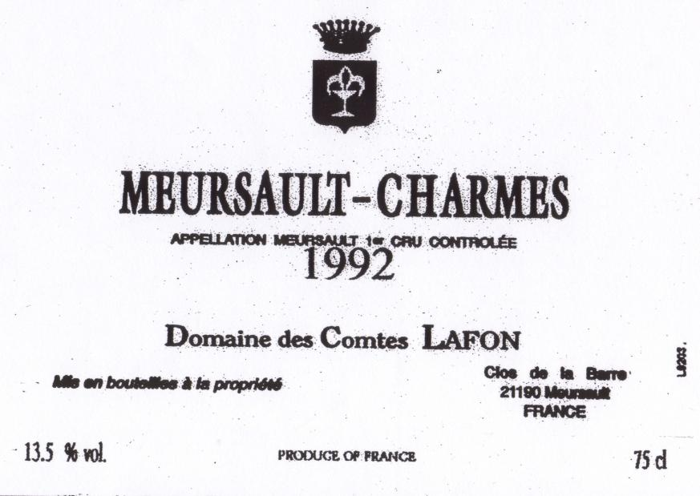
How to read a Wine Label
Level of quality and area
Vintage
Bottling information
Name of producer
Alcoholic strength
Country of Origin

Slide 14
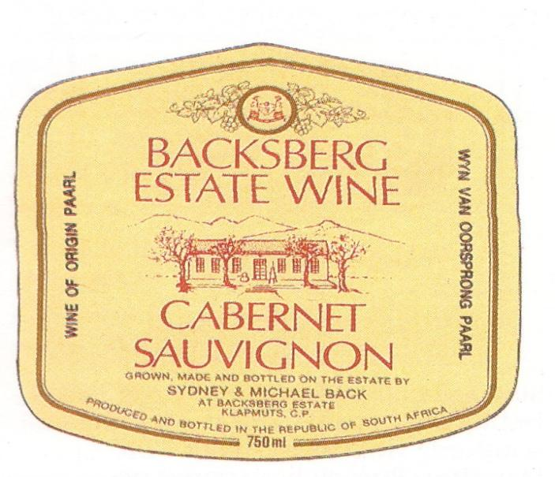
How to read a Wine Label
Grapes grown, Wine Made and Bottled on the estate.
South African Quality Level
Name of producers
Type of Grape used to make the wine
Country of Origin

Slide 15
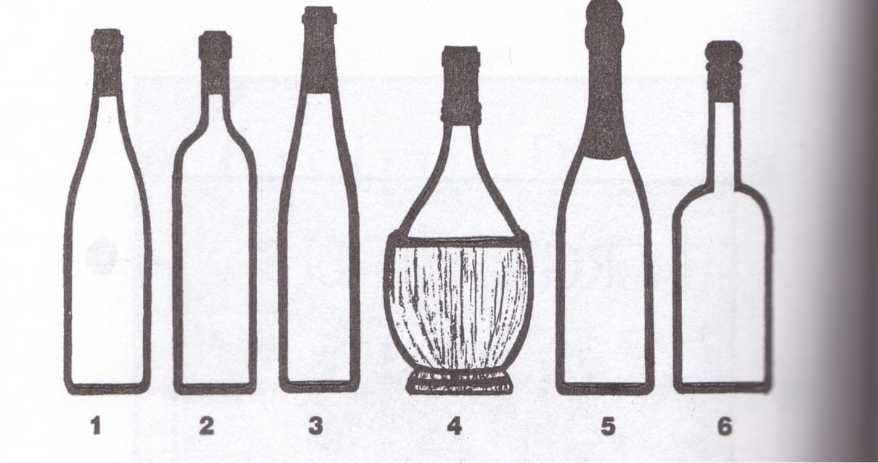
Various styles of wine bottles

Slide 16
Wine Bottles
Pale Green. Used in the Burgundy and Rhone regions. Used throughout the world for Chardonnay, Pinot Noir and Syrah
Dark Green. Used in the Bordeaux region for red wine and throughout the world for Cabernet Sauvignon, Merlot, Zinfandel. Clear Glass. Used for Bordeaux white wine. In other countries for Sauvignon Blanc and Semillon.
Brown. The Rhine region in Germany. Green in Alsace and Mosel. Associated with German grape varieties such as Riesling and Gewurztraminer.
Less Expensive Bottles of Chianti
Champagne and Sparkling Wine
Sherry & Port

Slide 17
The storage of wine
It is important to maintain wine at a suitable
temperature (between 10-14 °C) during storage because:
Wine is a living product which needs to be stored at an appropriate temperature in order to develop and mature in the bottle
Constant changes of temperature or storage in an environment which is too hot or too cold will damage the wine.
Wine bottles should be stored on their side to prevent the cork drying out and oxygen damaging the wine.

Slide 18
Service Temperature
Always bring new stock from the cellar or storage area to the service area as soon as possible. This will allow wines to be brought to their service temperature.
Do not bring out more stock than you require. Extended chilling can damage white wines and over-heating can damage red wines.
Once a red wine has been warmed to room temperature it should not be returned to a cold cellar. Frequent heating and cooling will damage wine.
It is better to serve a wine too cool rather than too hot. A wine will warm up gradually, but can be badly damaged if it is allowed to become too hot.

Slide 19
The correct temperature
Wines should always be served at the following temperatures:
Champagne & Rose 6-8 ° C
Sweet White Wine 8-10 ° C
Dry White Wine 11-13 ° C
Light bodied Red Wine 15-17 ° C
Full bodied Red Wine 17-19 ° C

Slide 20
Summary
The basics of wine making
Grape varieties
Wine producing areas of the World (particularly France, Italy, South Africa and Lebanon)
How to read a Wine Label
Different types of Bottles

